Slide 1
Micro-Pulsed Plasma Thruster

Slide 2
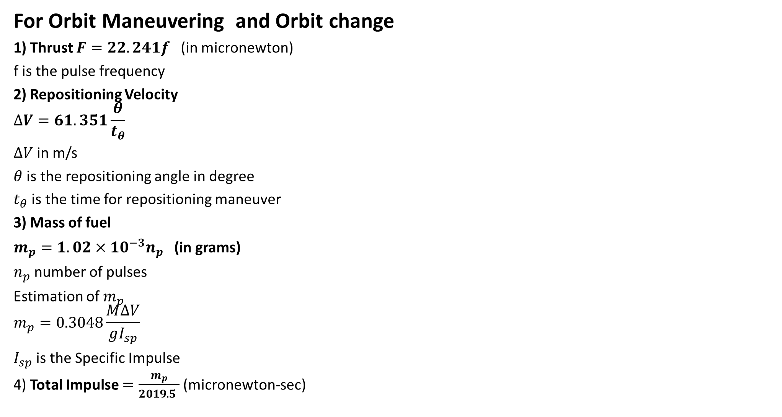
Thruster Parameters
For Orbit Maneuvering and Orbit change
1) Thrust $F=22.241f$ (in micronewton)
f is the pulse frequency
2) Repositioning Velocity
$$∆V=61.351\frac{θ}{t_{θ}}$$
$∆V$ in m/s
$θ$ is the repositioning angle in degree
$t_{θ}$ is the time for repositioning maneuver
3) Mass of fuel
$m_{p}=1.02×{10}^{−3}n_{p}$ (in grams)
$n_{p}$ number of pulses
Estimation of $m_{p}$
$$m_{p}=0.3048\frac{M∆V}{gI_{sp}}$$
$I_{sp}$ is the Specific Impulse
4) Total Impulse $=\frac{m_{p}}{2019.5 }$(micronewton-sec)

Slide 3
Mechanical Components
Component | Material | Chemical Composition
Electrodes | TungstenCopper Alloy | 72% W / 28% Cu
Spark Plug (W) | Tungsten | 99.5% Pure Tungsten
Spark Plug (Cu) | Copper | Copper
Covers(Upper, Lower and side), Nozzles, Macor Back plate | Macor(Machin able Glass Ceramic) | 46% SiO2-17% MgO 16% Al2O3 -10% K2O 7% B2O3-14% F
Boron Nitride Backplate | Boron Nitride | 40-42.6% B-49-52.9% N2 3-5% O2 -2-3% Ca 0.2% SiO2-0.4% B2O3
ShapalM Backplate | ShapalM | AIN
4 PPT Screws with 2 nuts each | Tecapeek GF30 | Polyetheretherketone 30% Glass Fiber
2 Negator Springs | Steel Wire | ASTM A228
Spark Plug Holder and Propellant | Teflon | Polytetrafluoroethylene(PTFE)
2 Teflon Bars | Teflon | Polytetrafluoroethylene(PTFE)
Mylar Shield | BoPET | Biaxially-oriented polyethylene terephthalate

Slide 4
Electronics and Electrical Components
Components | Properties | Dimensions (in mm) (L x B x H) | Operating Temperature (in C) | Mass (in g)
Pulse Transformer | 0.7 V-5 V (Input Voltage) 1200 V (Output Voltage) 417 uA (Output Current) 0.5 W (Power) | 12.7mm L *12.7mm H *12.7mm W | -25 C ~ 70 C | 4.3 g
Multilayer Ceramic Capacitor bank | 1 uF (Capacitance) 1000 V (Output Voltage) | 19.6mm L *18.3mm H *5.08mm T | -55 C ~ 125 C | 1 g each
Diode | 15 KV (Reverse Voltage) 610 mV (Forward Voltage) 550 mA (Forward Current) 200 A (Forward Surge Current) | 0.295'' dia*0.827'' L, 1.00'' Min Lead Length, 0.052''Lead diameter | 150 C MAX | 4.5 g each
TRIAC / MOSFET | operating voltage :-3kv current :-417 uA |  | -40 C ~ 70 C | 5-8 g each
LT3750 CHIP | Designed for the charging large capacitor |  | -40 C ~ 85 C | 2 g

Slide 5
Item | Quantity | Price (in Rs)
Ceramic Capacitor (Bank) | 25 | 40,000
Transformer (Power Supply) | 1 | 10,500
Diode | 15 | 6,750
TRIAC | 2 | 1,000
LT3750 | 1 | 600
PCB board | 1 | depends on design
TEFLON (Fuel) | 1 KG | 700
All Mechanical components (if sent for machining) | In terms of units | ~15,000 (Need to contact for actual price)
All Mechanical components (if material is individually bought) | In terms of mass | 40,000
 | TOTAL | ~1,00,000

